Slide 1
- KOREN Update -
TEIN NOC Workshop 2013 2013. 11.27.
KOREN

Slide 2
KOREN Update in 2013
Infrastructure status
Up to 60G backbone for testing network equipment capability
10~60G backbone is deployed nationwide (6 Pops)
About 60 connections to user site
POINTS and other facilities in place for the experiment
- MPLS-TP & ROADM Integrated System – Multi-layer Optical Network Ctrl Platform
Mesh environment (1G)as 1 G separate connection between POPs
Resources re-location
Distributed SDN/Openflow resources was re-located for efficiency .
Collaborate with Other resources
M2M testbed, Cloud nodes, Bigdata facility, Giga internet service infra and etc
Projects
(Awarded) SDN, Open contents , Mobile environment
5 Awarded projects are on-going now
Focus on future internet related issues
(TEIN related ) eTEIN KOREN Project
SDN, IPTV, Traffic control projects(DPI )

Slide 3
Backbone
10G
Mesh Network
TEIN4
(HK)
10G
Seoul
(NIA)
Seoul
2.5G
KOREN
TEIN4
(SG)
10G
GEANT
(EU)
60G
Daejeon
Suwon
Gwangju
Daegu
APII
10G
Busan
Daejeon
10G
Optical add/drop node
1G
Daegu
JGN-X
(JAPAN)
10G
10G
TransPAC3
10G
Busan
Gwangju
Internet2
(USA)
1G
Jeju
2013. Jan.

Slide 4
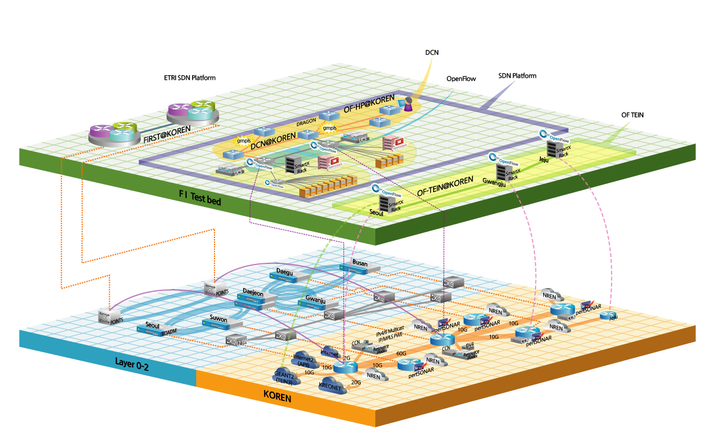
FI Testbed in KOREN
Notes:
DCN(dynamic Circuit Network) 환경이 KOREN POP에 구축되어 있으며, 이를 통하여,
일본과 미국으로 DCN이 연동될 수 있는 환경이며,
모니터링을 위해 perfSONAR, 자원 예약을 위한 웹 기반 환경을 마련해 두고 있습니다.

Slide 5
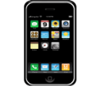
KOREN Update in 2013
New domestic backbone preparation
Backbone architecture is under planning and discussion
- Will deploy 100G backbone(Seoul~Daejeon)
Centralized resources for better experimental environment and easy to operate and support
Additional resource could be added
Mobile research facility would be attached to KOREN
- LTE related technology will be tested
- expect to start in top of 2014
Access testbed
Core test infra[EPC]
S-G/W
P-G/W
KOREN
Verification
UE(wireless
device)
HeNB(basestaion)
-LTE Femto
MME
HSS
AuC
Notes:
미래인터넷 환경은 다양한 멀티미디어를 이용하는 무선기반의 기술 트렌드로
급변함에 따라 KOREN내 무선분야의 시험 환경 구축 필요
유무선 융합서비스 등 차세대 미래인터넷 서비스에 대한 시험 및 시범서비스를 위해 유무선 통합 Access 망 구축
LTE 소형 기지국(펨토셀), WiFi AP등으로 구축
P-G/W(Packet Data Network Gateway, 유선망(KOREN 등)과의 연동 역할)
S-G/W(Serving Gateway, LTE 기지국과의 연동 역할)
MME(Mobility Management Entity, 단말의 위치등록, 호처리 등 무선망 연동관리)
HSS(Home Subscriber Server, 가입자 위치등록) , AuC(Authentication Center, 휴대폰 인증시스템

Slide 6
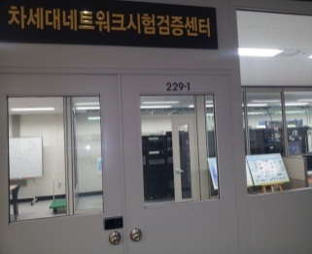
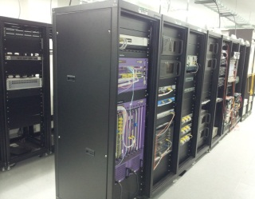
Verify R&D results
Test & verification Center for next generation network
Deploy environment testing & verifying research output for advancement of R&D projects
Locate test environment in KOREN based environment
Co-work with R&D Projects partners
Support test of commercial equipment
- Issue test result report.
Activities
Make test procedure for each candidate project
Share test equipment with research community(industry, university, and research institutes)

Slide 7
Other Testbeds
M2M testbed
Deploy M2M testbed for pilot service (co-work with KCA)
Provide testing and developing toolkit and service platform
Connect with KOREN to M2M support center for testing
Cloud environment
Providing virtual resources to researchers(individual, univ. , industry)
About 100 computing nodes would connect to KOREN this year and would provide cloud infrastructure and virtual resources
BigData analysis platform
Providing resources which could make Bigdata related technology and service based on public data
KOREN provide connectivity to someone or company which want to access Bigdata facility.

Slide 8
Projects awarded
Research collaboration of practical experiment
Expansion and Improvement of Openflow based SDN experimental infrastructure
Open Contents transmission testbed
Open mobile testbed
Practical experiment of prototype product
Realtime traffic centralized control technology
Cloud designated Switch technology

Slide 9
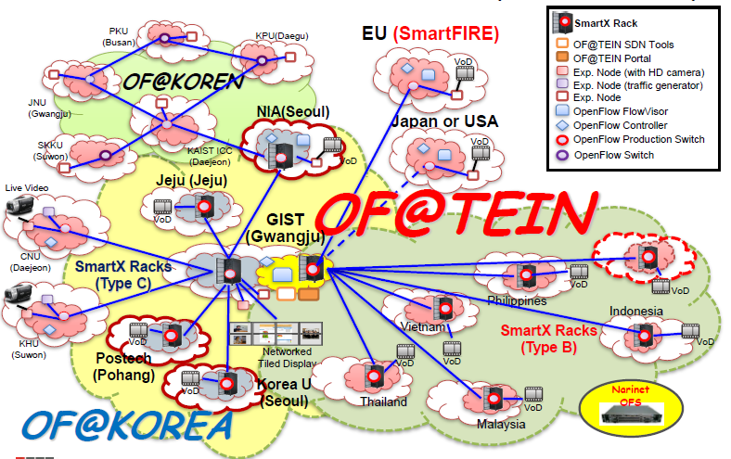
SDN/Openflow R&D
OF@TEIN 2013
OF-based SDN Testing Infrastructure
Existing SmartX Rack(Type A/B) expansion and operation
New SmartX Rack(Type C) Design and Prototyping
OF@TEIN SDN service Experiments & cooperation with partners

Slide 10
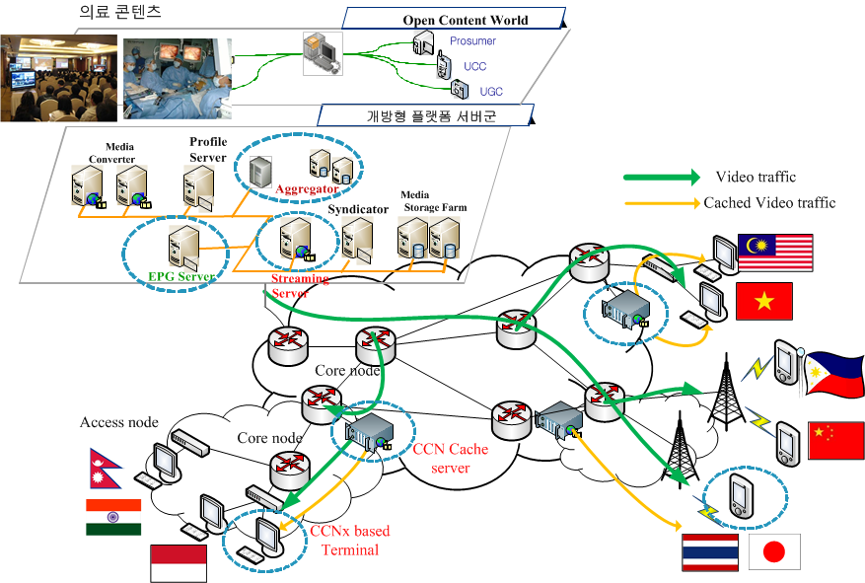
Open Web IPTV
Develop open contents transmission platform and deploy testbed
Develop web based contents delivery platform
Develop web based contents gathering tech (medical contents)
Video service test with using CCN tech.
QoS/QoE measurement research via contents delivery
Deploy global contents delivery research testbed

Slide 11
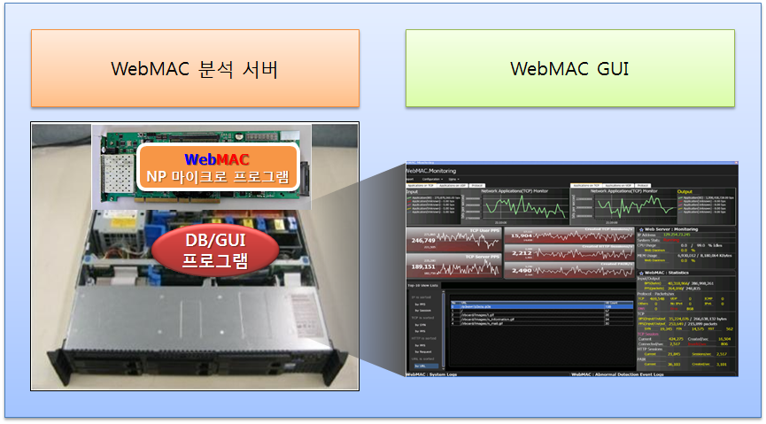
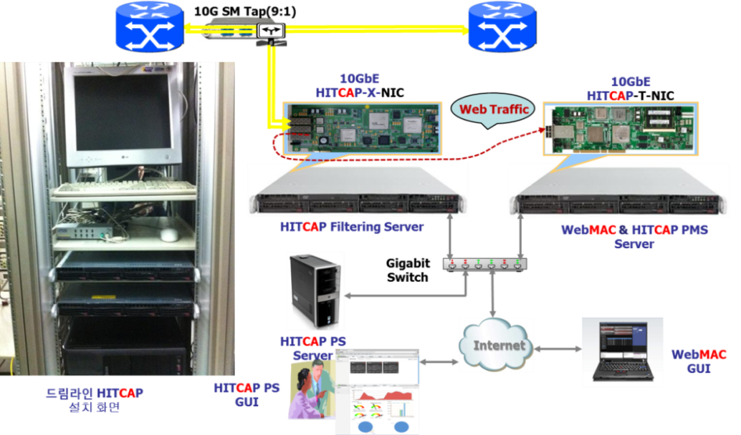
Realtime traffic control
Deploy and test realtime traffic control function
10Gbps level web traffic analysis and monitoring
Develop GUI for monitoring
Domestic function test
Practical test with placing prototype system in TEIN POP (HK, SG)

Slide 12
Plans
Backbone Restructuring is expected in 2014
- Focus on testing & verifying of ICT technology
- Enable flexible environment for future internet research
- Expand based on existing facilities(OF/SDN, mobile and so on)
Participating Various pilot project
- BigData analysis, Giga Internet, M2M, Clouds and etc.

Slide 13
Thank you
noc@koren.kr

